Slide 1
Politics in Nigeria
Chapter 18

Slide 2
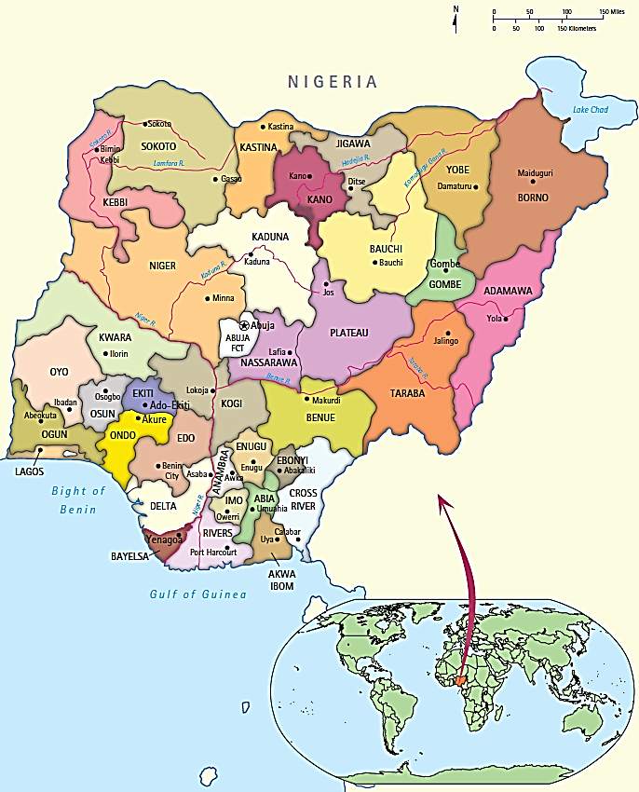

Slide 3
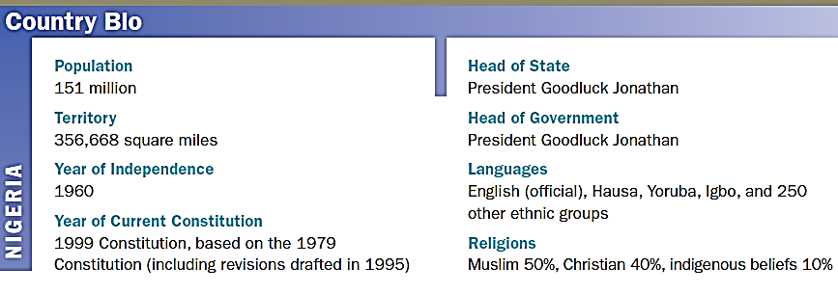
Country Bio: Nigeria

Slide 4
Comparing to the Rest of Africa
Nigeria is a megastate!
Larger than Britain and France
1/5 of Africa’s population
World’s largest black population
International Importance
Large petroleum reserves
Large standing military
104 universities makes it the center for learning and research in Africa.

Slide 5
Policy Challenges
They are enjoying the largest period of civilian rule in history.
Running into ethnic, regional and religious conflicts.
Political elites and separatist groups are calling for a weak federation or more independent states
Declining quality of elections are hurting perceptions of democracy.

Slide 6
Democratization Begins
1999—Olusegun Obasanjo was elected democratically, and a few weeks later a democratically elected legislature followed
2003 reelection by a landslide
2007---Obasanjo supporters attempt to amend the constitution to allow an additional term
Umar Musa Yar’Adua was elected president
He falls ill in 2009 which challenged the constitution

Slide 7
His Illness and Chaos
YAR'ADUA ILLNESS TIMELINE
23 November 2009 Goes to hospital in Saudi Arabia
26 November Presidential doctors say he has pericarditis - inflammation of the heart lining
23 December First court case filed urging him to step down
5 January 2010 Two more court cases filed, rights group wants president declared "missing"
12 January President gives first interview from Saudi Arabia
27 January Cabinet declares president fit
29 January Court says no need for formal transfer of power
9 Feb: Vice-President Goodluck Jonathan becomes acting president
24 Feb: Yar'Adua returns
5 May: Death
(http://www.youtube.com/watch?v=cELhxqxeK54)

Slide 8
Failures of Democracy?
Aside from political turmoil, Nigeria also faces these issues:
A lack of government social welfare (education, health, potable water, transit and communication).
Low power generation (since 1999)
Which complicates private investment
Per Capita income is 1/10th of that in the US or west Europe
158/182 on the HDI
130/180 on Transparency International’s Corruption Index

Slide 9
Other Struggles
Previous democratic attempts in Nigeria have failed, but the current government is slowly evading the fate of previous democracies.
Sectarian violence (ethnic/regional/religious lands)
Tempted with authoritarianism since democracy is failing.
Several problems stem from a past of colonialism etc.

Slide 10
Democracy vs Tradition
http://www.youtube.com/watch?v=xpZjULlUo6U

Slide 11
Thinking about Nigeria
Key questions
How is the legacy of colonialism reflected in Nigerian politics?
What role does ethnicity play in reinforcing the country’s difficulties?
Why does Nigeria remain one of the poorest countries in the world despite its massive oil and natural gas reserves?
How have frequent shifts from civilian to military rule and back again exacerbated the country’s many social and economic problems?

Slide 12
The Evolution of the Nigerian State
Before the British
Numerous well-developed political, cultural, and economic systems
Hausa states in north
Yoruba kingdoms in west and southwest (and neighboring Benin)
Igbo villages in southeast and Niger Delta
Portuguese slave trade of late 15th century

Slide 13
The Evolution of the Nigerian State
Colonialism
British colony at Lagos as base for trade in early 19th century
International Berlin West Africa Conference (1885)
European nations’ glory and balance of power in play
Europeans wanted new markets
Christian missionary and civilizing impulses

Slide 14
The Evolution of the Nigerian State
Colonial rule
Single Nigerian colony in 1914
Indirect rule in north; colonial regime in south
Education system by missionaries with government support (mostly in south)
Created a new Nigerian elite
Made possible a domestic, critical press
British tried to make colony self-supporting
Introduced cash crops; forced colony to import food
Colonial industries made wage laborers out of Nigerian producers

Slide 15
The Evolution of the Nigerian State
Independence
First drive for independence came with WWI
WWII made independence inevitable
British promulgated constitution (1946)
October 1960 elections and independence

Slide 16
The Evolution of the Nigerian State
Burden of problems inherited from colonial times
Inhibits national identify formation:
colonial rule (direct in the south/indirect in the north) created regional identities and rearranged boundaries.
Ethnic and religious division and tensions
indigenous and Christian religions in the south, Islam in the north; underlying ethnic identities rearranged boundaries.
Residual colonial institutional and cultural features
bureaucracy, language, colonial boundaries
Dependency
extractive economic relations with the West and former colonial power; neocolonialism (continued exploitation)

Slide 17
System of government
Westminster and procedural features of western democracy
Ineffective civil society and weak democratic consolidation
Imposed national boundaries

Slide 18
The Evolution of the Nigerian State
The First Republic
Traditional parliamentary system
Federal system
Nigerian political culture unsuited to adversarial system (not everyone represented)
High stakes politics and corrupted elections led to overthrow of regime

Slide 19
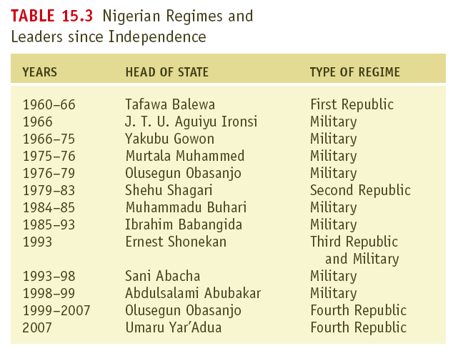

Slide 20
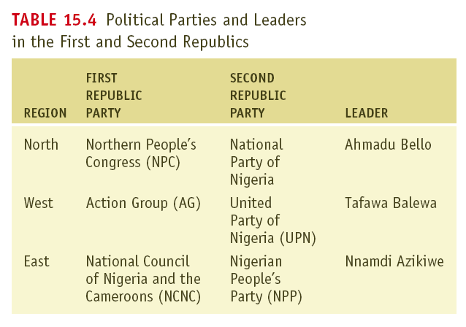

Slide 21
The Evolution of the Nigerian State
Military Rule I
Justified by the need to restore order
Ethnic divisions
Civil war
Coup follows coup follows coup

Slide 22
The Evolution of the Nigerian State
The Second Republic
Presidential system
Government-licensed political parties
Contested election
Oil price collapse and economic disaster
Corrupt, violent elections (1983)

Slide 23
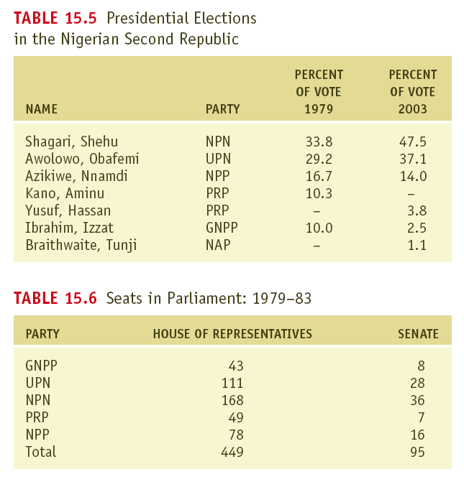

Slide 24
The Evolution of the Nigerian State
Military Rule II
Coup to restore democracy
Counter coup because of favoritism
Constitutional engineering to create viable regime
Coup in response to conflicts within ruling junta

Slide 25
The Evolution of the Nigerian State
Military Rule III
More authoritarian than previous military regimes
As corrupt as any government
Fourth Republic
1999 election of Obasanjo
2007 election of Yar’Adua

Slide 26
The Fragile Nigerian State
The Fourth Republic
American-style presidency
National Assembly similar to U.S. Congress
Anglo-American style judiciary
Network of local and state courts with a Supreme Court
Sharia appellate court option for states

Slide 27
Selecting an executive
Direct popular election
Variety of candidates
Fixed election cycle
President cannot run for a third consecutive term

Slide 28
Nigerian Executive
Presidential Structure
Acting President: Goodluck Jonathan
Serves as Head of State and Head of Government
Independently elected according to the 1999 Constitution.
President must be a citizen of Nigeria, at least 40 years of age, and be sponsored by his political party.
Limited to two terms of office, four years each.
Unique Features
Military coups.
The Nigerian Parliament is more compliant.
Parties play a more significant role in empowering the Nigerian president because his party controls the legislature and helps get his agenda passed.
The Nigerian President receives more international support.

Slide 29
Goodluck Jonathan
Controls:
Military and Police
Federal Ministries (the Cabinet)
Federal Civil Service
Revenue Allocation System
Federal Commissions
Signs bills and refers back to Assembly
Appoints ambassadors, etc.

Slide 30
The Fragile Nigerian State
The Personalization of Power
Person in position more important than formal responsibilities and powers of office
Corruption - massive and ubiquitous

Slide 31
The Fragile Nigerian State
Federalism
Blunted ethnic conflict
Uncertainty about powers of states
Duplication of services and bureaucracies
Preserved ethnic divisions

Slide 32
Nigeria and the Plight of the Third World
Should there be a Nigeria?
Prospects for national reorganization in Africa very unlikely
Solutions will have to come within current national boundaries.

Slide 33
Participation in Nigeria
Identify areas in which discussions of political policy take place in some of the countries studied so far….
Possible Answers:
Informal family discussions
News media
Advertising media
Civic groups
Formal Political Settings (Political parties, campaigns, interest groups, lobbying, and government committees and ministries)
How do discussion arenas differ from decision-making arenas where policies are actually adopted?
Conflict
Accuracy of information

Slide 34
Identity Politics in Nigeria
prebendalism

Slide 35
Background to prebendalism
Traditional Nigerian societies were village societies:
Nearly everyone was related to everyone else
Survival and well-being depended on cooperation and sharing.
There was NOT a great difference in wealth and income. EVERYONE TOOK CARE OF EVERYONE ELSE IN THE VILLAGE!
This mindset spread throughout Nigeria even after British colonial occupation.
This concept is foreign to many Americans
Example: Hillary Clinton, It Takes a Village

Slide 36
Definition
Prebendalism is the version of identify politics practiced in Nigeria
Prebend = salary paid to a clergymen from a special fund administered by his church or cathedral.
In Nigeria, prebendalism describes the common notion that a person elected to or employed by the government is ENTITLED to benefit from the position.
Those who are elected or hired are also entitled to a share of the benefits that come with power and control of government spending.
It is the disbursement of public offices and state rents to one’s ethnic-based clients.
An extreme form of clientalism that refers to the practice of mobilizing cultural and other sectional identities by political aspirants and officeholders for the purpose of corruptly appropriating state resources.

Slide 37
Further Discussion of Nigeria…

Slide 38
Feedback
Relatively free press (even under military regimes)
Low literacy rate
Government-controlled broadcast media key to feedback
State broadcast stations now compete with national network

Slide 39
Public Policy
Economic development and structural adjustment
Export-based economy vulnerable
Oil prices have created crises and opportunities
Import substitution has not worked well
Structural adjustment results mixed

Slide 40
REVIEW: What are patron-client networks?
Relationships between higher-up individuals (patrons) and a subordinate individual (client). Each benefits from the relationship as political favors are given by the patron in return for support from the client.
What is the name for the system in Nigeria? Mexico?
In Nigeria such relationships are called prebendalism and in Mexico it is called the camarilla system.

Slide 41
REVIEW: What is an Ethnic Cleavage? And what are the three major cleavages in Nigeria?
Differences or division in the characteristics of a population.
Ausa-Fulani, Igbo, and Yoruba

Slide 42
Ethnic conflict in Nigeria….
There are hundred of ethnic groups and conflicts occur over religion, economic status and traditions.
Hausa-Muslim group who dominates North while the rest of the country is largely Christianity or indigenous religions.
“…democratic compromise difficult. The different groups clamor for scarce resources and for control of the government. This leads to what Daniel Chirot refers to as "democratic paralysis”…”

Slide 43
What has Nigeria done to reduce ethnic conflict?
Require that political parties have broad popular support.
This is done by the National Election Commission (NEC), a commission that requires presidential candidates have support from a variety of regions.
It also establishes guidelines for party formation.
Obasanjo’s contributions:
Attempting to create a more stable and open society.
Nigeria has divided funds more equitably among the states.
One member from each state in his cabinet.

Slide 44
How has the government’s response to ethnic conflict impacted political stability in the country?
There has been moderate success.
Obasanjo was elected using the rules of the FEDCO (now the INEC) and has remained fairly popular with many groups.
He is one of the few Nigerian politicians not elected because of ethnic origin.
However…
Ethnic conflict continues as evidenced by “…some Nigerians have using these new democratic freedoms as a justification for advancing separatist sentiments, including religious fundamentalism and other potentially antidemocratic, destabilizing ideologies.”

Slide 45
How has Nigeria democratized its political process?
Implementation of new constitution eliminating military rule.
Freer press.
Reappearance of regular elections; elections have continued since 1999)
Protections for ethnic and religious groups
Redrawing of state boundaries to increase representation (including increasing the number of states).
Direct election of president to increase legitimacy.
Creation of Independent National Electoral Commission (INEC)

Slide 46
However…
There has been some resistance to Nigeria’s democratization:
Coups d’état
Introduction of Shari’ah law into some states (Zamfara) has undermined democratization.
Illegitimate elections.
Military resorting to violence.
Poor human rights record (Odi).
Persecution of Ken Saro-Wiwa and others

