Slide 1
The Politics of great Britain
A Chapter 8 production

Slide 2
Objectives throughout chapter 8
Understand and distinguish the structures of government in Britain.
Compare and contrast the political systems of Britain and the United States.
Understand the “special relationship” between Britain and the United States and recent developments in this relationship.
Understand the concept of an unwritten constitution and how democracy can function without a written constitution.
Discuss and debate the different theories of government that shaped British politics.
Understand how the political culture of Britain has shaped its government.
Understand how socialization, interest articulation, interest aggregation, and the electoral system function in Britain.
Understand the concepts of centralization and decentralization in relation to the government structure in Britain.

Slide 3
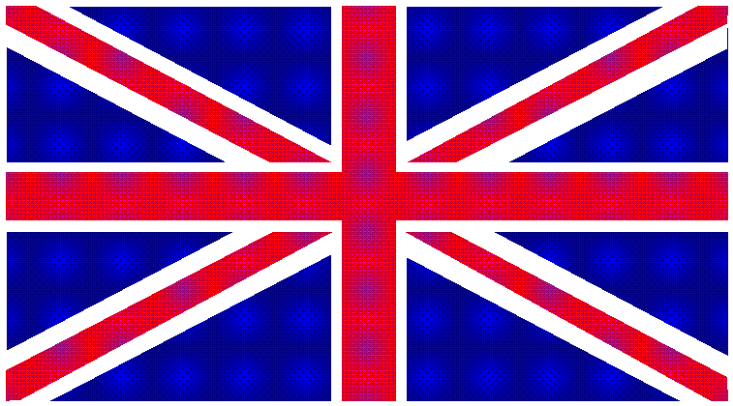
GREAT BRITAIN

Slide 4
On England
William Shakespeare:
"Richard II" Act 2, Scene 1, 32~48
"This royal throne of Kings, this scepter'd isle,
This Earth of majesty, this seat of Mars,
This other Eden, demi~paradise,
This fortress built by Nature for herself,
Against infection and the hand of war,
This happy breed of men, this little world,
This precious stone set in the silver sea,
Which serves it in the office of a wall,
Or as a moat defensive to a house,
Against the envy of less happier lands,
This blessed plot, this Earth, this Realm,
this England."

Slide 5
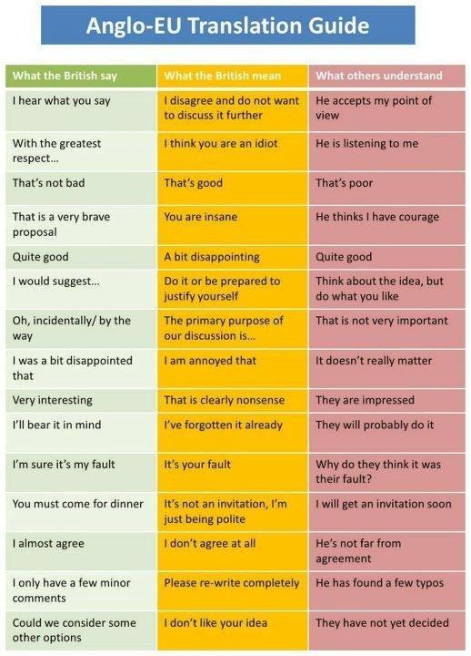
Not exactly Shakespeare

Slide 6
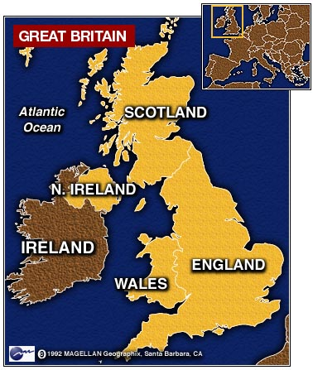
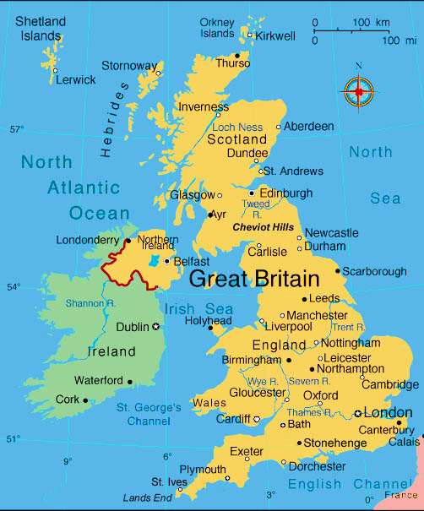
United Kingdom of Great Britain and Northern Ireland

Slide 7
Geography
Great Britain includes England, Wales, and Scotland
Second largest island includes Northern Ireland and the independent Republic of Ireland.
Offshore island adjacent to Europe
Creates feeling that Britons are separate from but a part of Europe
Complicates relations with European Union – Why?

Slide 8
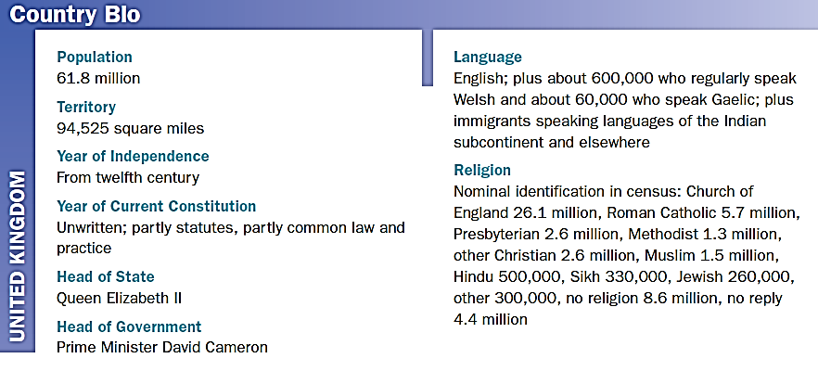
Country Bio: United Kingdom
Notes:
8

Slide 9
History, Policy Challenges, Political Environment,
Section 1

Slide 10
Evolutionary vs. Revolutionary democracy
Britain is labeled as an “old democracy.”
However, it is an evolutionary democracy (over a period of 800 years).
Places like the US are considered Revolutionary Democracies
What is the simple difference between these two labels?
In 1801 the United Kingdom was born:
A unification of England, Scotland, Wales and Ireland under the authority of the British Parliament that is located in London.
Since then, the crown has forfeited its claim to Ireland, and now the UK is:
England
Scotland
Wales
Northern Ireland

Slide 12
Time Line of Political Development
1215 | King John forced to sign Magna Carta
1295 | first representative Parliament convened
1529 | Henry VIII convened ‘Reformation Parliament,’ began process of cutting ties to Roman Catholic church
1628 | Charles I forced to accept Petition of Right, Parliament’s statement of civil rights
1642-48 | English Civil War: Royalists vs. Parliamentarians
1649 | Charles I tried and executed
1689 | Parliament issues bill of rights establishing constitutional monarchy
1707 | Act of Union united kingdoms of England and Scotland

Slide 13
Evolutions in the British system
The Creation of Parliament (1066)
Magna Carta (1215)
English Bill of Rights (1689)

Slide 14
The Development of Parliament (1066)
The Parliament of the United Kingdom of Great Britain and Northern Ireland is the supreme legislative body in the United Kingdom, British Crown dependencies and British overseas territories.
Located in Westminster, London.
Parliament alone possesses legislative supremacy:
Has ultimate power over all other political bodies in the UK and its territories.
The head of Parliament: Sovereign, Queen Elizabeth II.

Slide 15
The History of parliament
The Parliament of Great Britain was formed in 1707 following the ratification of the Treaty of Union by both the Parliament of England and Parliament of Scotland passing Acts of Union.
However, in practice the parliament was a continuation of the English parliament with the addition of Scottish MPs and peers..
It has been called "the mother of parliaments", its democratic institutions having set the standards for many democracies throughout the world.
In theory, supreme legislative power is vested in the Queen-in-Parliament; in practice in modern times, real power is vested in the House of Commons, as the Sovereign generally acts on the advice of the Prime Minister, and the powers of the House of Lords have been limited.

Slide 16
Structure of Parliament and House of lords
The parliament is bicameral:
Upper house: the House of Lords,
Lower house: the House of Commons.
The Queen is the third component of the legislature.
The House of Lords
two different types of members:
the Lords Spiritual (the senior bishops of the Church of England)
the Lords Temporal whose members are not elected by the population at large, but are appointed by the Sovereign on advice of the Prime Minister.
Prior to the opening of the Supreme Court in October 2009 the House of Lords also performed a judicial role through the Law Lords.

Slide 17
The House of Commons
The House of Commons is a democratically elected chamber with elections to it held at least every five years.
The two Houses meet in separate chambers in the Palace of Westminster.
By constitutional convention, all government ministers, including the Prime Minister, are members of the House of Commons or, less often, the House of Lords.

Slide 18
The Magna Carta (1215)
Put pressure on King John to put forth a list of liberties.
Ended “punishments outside of the law” for “freemen”
Limited powers of the King.
First document forced on a King by his subjects
The Guardian UK--On the 800th aniversary of the Magna Carta

Slide 19
English Bill of Rights (1689)
Lets look at the EBoR
How did our founders differ from the EBoR?

Slide 20
Policy Challenges—2010 Elections
The general election of 2010 has faced British party leaders with their biggest political challenge in more than half a century.
The Conservative Party under the leadership of David Cameron came first with 307 seats; the outgoing Labour government of Gordon Brown trailed in second place with 258 seats, and the Liberal Democratic Party led by Nick Clegg came third with 57 seats.
The coalition government's chief offices are divided between Conservative David
Cameron as prime minister and Liberal Democratic leader Nick Clegg as deputy prime minister. The first challenge facing the government is to keep the coalition together.

Slide 21
More Contemporary issues
Some Liberal Democrats were unhappy because they consider their policies closer to the Labour Party on, for example, which programs to cut and which taxes to increase in order to deal with the government’s massive budget deficit.
Every British prime minister claims a special relationship with the United States.
The coalition government faces a double challenge: to reduce the size of the government's deficit and to stimulate a return to economic growth. Most Conservatives want to give priority to spending cuts, while most Liberals are prepared to maintain higher spending financed by higher taxes.

Slide 22
One Crown—Five Nations
In international law, the state is the United Kingdom of Great Britain and Northern Ireland. Great Britain is divided into England, Scotland, and Wales. The fourth part of the United Kingdom, Northern Ireland, consists of the six counties of Ulster.
The United Kingdom is a unitary state because there is a single source of authority, the British Parliament. However, the institutions of government are not uniform throughout the Kingdom.
Historically, Scotland and Wales have been governed by British Cabinet ministers accountable to Parliament.

Slide 23
Northern ireland……
Northern Ireland is an anomaly; three-fifths of its population is Protestants who wish to remain part of the United Kingdom, while most of the rest are Catholics who wish to be united with the country of Ireland.
Since 1968, non-violent protests by Catholics and violent actions by the Irish Republican Army (IRA) pushed for secession. In 1998, a power sharing agreement meant to end the violence through power sharing was signed, but the executive collapsed in 2002.
In March 2007, Prime Minister Ian Paisley agreed to a power-sharing agreement with representatives of Sinn Fein, the former political arm of the IRA.
Zombie

Slide 24
One pound = ~$1.60

Slide 25
Read p. 154-155 and 160-162 (to the structure of government)
Your Homework Assignment

Slide 26
Governmental Structure, What the PM Says/does, The Cabinet,
Section 2

Slide 27
Semantically Discussing the government
Queen’s Government:
An enduring non-partisan government.
Labour/Conservative Government
A government that focuses on Party Identity
David Cameron’s Government
A government that focuses on faith in/ strength for the PM.

Slide 28
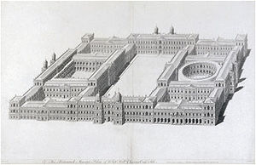
Whitehall
The departments headed by Cabinet Ministers
This is the bureaucratic and quasi-executive wing of the government.
This is named after the Palace of Whitehall where monarchs lived from 1530-1698.

Slide 29
Downing Street
#10 Downing Street is the address of the prime minister, where he lives and works.
It’s the British equivalent of the White House

Slide 30
Parlaiment

Slide 31
Westminster
This is a term of reference to all of the above.
Westminster is the district that includes all of the above institutions.

Slide 33
Lack of a written constitution
The UK has no written Constitution.
It is a jumble of:
Acts of Parliament
Judicial Pronouncements
Customs
Conventional Political Rules
Benefits
Fewer restrictions
More flexibility
Easy changes with acts of Parliament vs Con Con

Slide 34
A Lack of Checks and Balances
No one can declare an act of Parliament unconstitutional, or strike it down
Unless a new act of Parliament strikes it down.
The buck stops with the Public
If the people do not like acts of Parliament they will elect governors who are more trustworthy.
If legal recourse is necessary, they may evoke the European Convention of Human Rights, or the 1998 British Human Rights Act.

Slide 35
What the Prime Minister Says and Does
Political Leader
Ambiguous Duties
Imperatives of the Prime Minister:
Winning elections
Campaigning through the media
Patronage
Parliamentary performance
Making and balancing policies

Slide 36
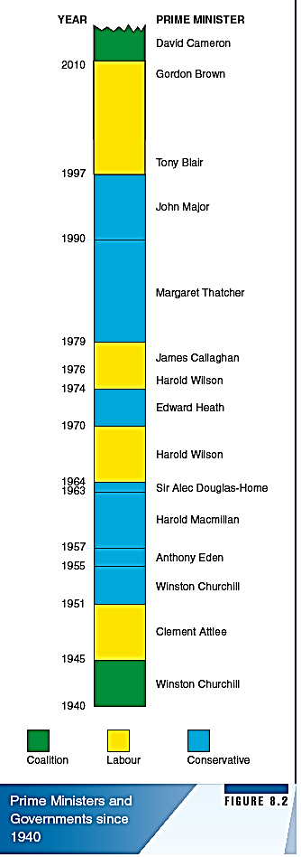
Winning elections
The primary goal is to make sure the party is popular with the public and that (s)he can control when elections happen to ensure a high re-election rate of MP’s from their party.
There have been only 7 prime ministers since 1945 and 18 elections.
During those 18 elections, 10 times the reigning PM was victorious.

Slide 37
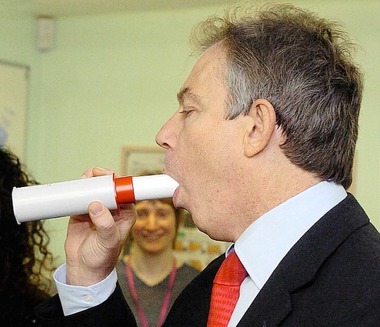
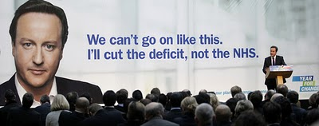
Campaigning through the media
He is the face of the government, all actions of Parliament are based on the actions of the PM, if he looks bad, the party looks bad.
People also judge the PM based on their personality.

Slide 38
Patronage
To remain the PM, you must keep the confidence of the party (or parties if in a coalition government).
To satisfy political opponents/critics (from your party) the PM can:
Promote them to a minister (make them a front-bencher)
Hope that backbenchers will wait for the opportunity to impress the PM for future chances at becoming a frontbencher.
When dispensing patronage, PM’s use four criteria:
Personal Loyalty (rewarding friends)
Co-option (described above)
Representativeness (choosing reps from minority groups)
Competence in direction for a particular department.

Slide 39
Parliamentary performance
The PM attends a weekly meeting in the House of Commons answering questions for half an hour.
Margaret Thatcher
Cameron's First PMQ
Top 5 Moments of 2000-2010
No scripts, no teleprompters, no speechwriters, he must face the firing squad, he can judge the feelings of the government, and they can see how good of an advocate of policy he is.

Slide 40
Making and Balancing Policies
He deals with other governments around the world, Downing Street is the architect of foreign policy.
Also, he must balance the policies of his cabinet ministers to ensure domestic policy is solid.
For an analysis of individual PM’s and their actions please check out 165-166

Slide 41
The deputy in a coalition
Must ensure that the coalition pact is being met by the majority party.
Has to keep the ministers who received patronage in check.
Can secure some media attention on issues that are beneficial to the Liberal Democrats.

Slide 42
The Cabinet
All cabinet members must be a member of the House of Lords or House of Commons.
As ministers they are still MP’s
Meeting frequency and duration vary
Historically: twice a week for as long as they needed
Blair: less than once a week and reduced length to less than an hour
Coalition: increased frequency so parties can work together

Slide 43
Cabinet Posts
The 2010 Cabinet contains:
External Affairs: Foreign Policy
Economic Affairs: Treasury, business, innovation, energy, transportation
Legal/Constitutional Issues: Works with Supreme Court and Lord Chancellor, Home Office and Women’s Affairs
Social Services: Culture, media and sport
Territorial: Environment, food, rural affairs, territorial offices (E,S,W, NI)
Managing Government Business: Lord President of the Council, Deputy PM, Leader of the House of Commons, Chief Whip, Leader of the House of Lords

Slide 44
Read 168-172
Your Homework Assignment

Slide 45
Theories of Governance, Political Legitimacy, Political Socialization, Interest Groups and Parties
Section 3

Slide 46
Political Culture
PC: values and beliefs of how a country ought to be governed.
Country should be governed by a popularly elected parliament.
The government ought to provide social welfare (education, healthcare, social security)
Open free speech policies, freedom of sexual choice.
How should the government regulate the economy and work with the EU are the biggest questions/issues

Slide 47
Theories of Governance
Trusteeship Theory
Leaders ought to take initiative in deciding the public interest
“The government’s job is to govern”
Popular with majority parties so they can do what they want.
Collectivist Theory
Balance the demands of different social groups.
Groups are more important than individuals.
Many political leaders distance themselves from this as groups come primarily from individuals.
Individualist Theory
You should represent people and not the groups.
MT: “No such thing as society”
Most prevalent theory in Britain for the longest time.

Slide 48
Government Legitimacy
It is “legitimate”
People pay taxes, cooperate with public officials
Many criticisms that make them distrust the government
Elitism
MP’s spend too much money
Too much mudslinging
Party Distrust
Less than 1 in 5 trust a party
They believe the party and the press are too manipulative
Less than half of the population trust civil society organizations.

Slide 49
Dissatisfaction
World Values Survey
Everyone says they might sign a petition
Half of the Britons say thy may participate in a lawful demonstration of protest
One sixth says they are willing to unlawfully protest or occupy somewhere.
Primary sources of dissatisfaction
The Economy
Northern Ireland and rejection of the crown
Other sovereignty issues

Slide 50
Political Socialization

Slide 51
Family and Gender
Children tend to identify with the party of their parents
No strong differences in views between men and women
Big difference in political participation
2/3 of local government officials are men
50% of social service are women, trapped in clerical jobs
House of Commons
142 women elected (less than 1/4)
4 female ministers in the cabinet

Slide 52
Education
Median voter left school by the age of 17
2/5 of all Britons attend college, but they are not strong research universities.
Education does not really indicate party affiliation, as voters with a degree divide their votes across the 3 parties.
Biggest divider from education is in terms of who participates.
More education = higher of climbing of the political ladder
Maybe slowly tending to becoming a meritocracy.

Slide 53
Class
Conservative: Middle-Class
Labour: Working Class
Class is the most important division in the UK
Manual vs Nonmanual workers
Technical jobs are in the “middle class”
The bonds of class to party is slowly becoming irrelevant.

Slide 54
Media
Most people focus on the internet for their information.
There are 6 “credible” newspapers
Times, Guardian, Daily Telegraph, Independent, Financial Times.
Some say these are more credible or intellectual than American newspapers.
Television
Many MP’s say the media pushes political cynicism
It is the primary source of political news
There is a ban on TV/Radio political ads sold to politicians, ads, or parties.

Slide 55
Political Participation

Slide 56
For Reading tonight 185-190

Slide 57
The uk group will cover 181-185, please add their content to your notes

