Slide 1
Politics in Mexico
Chapter 14

Slide 2
Current Policy Challenges And Historical Perspectives,
Lecture 1

Slide 3
Your reading homework
P. 435 (Political Culture) to 440 (Political Structure and Institutions)

Slide 4
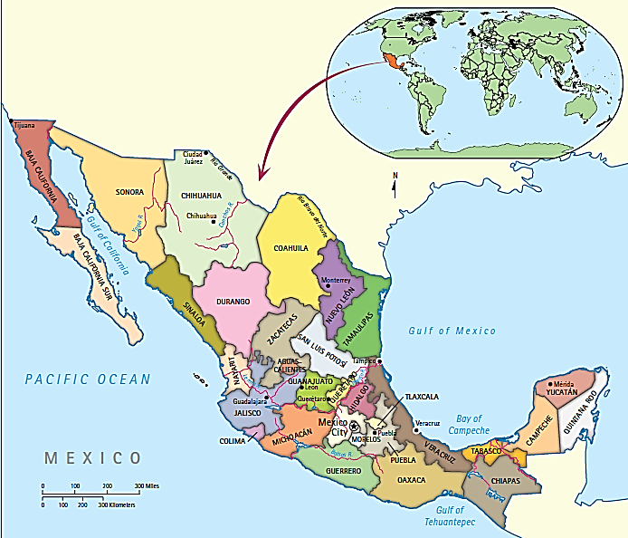

Slide 5
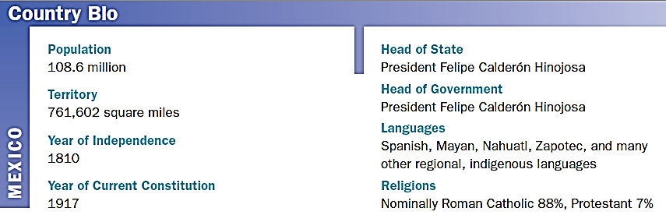
Country Bio: Mexico

Slide 6
The 2006 Presidential Election
The similarities between the 2000 US Presidential Election and the 2006 Mexican election are remarkable
Anxious public watching TV coverage of election night
Both candidates claim TV Victory
Recounts are called
Bias is labeled
Months pass until the lawyers and courts declare a winner

Slide 7
The Dominance of the PRI
For 6 decades, the PRI had dominated politics
PRI = Partido Revolucionario Institucional
As soon as they nominated a candidate, the Mexican people knew who their president would be.
Evolution to a more-democratic system starts in 1988
A fraud ridden election where the PRI slowly starts losing their grips on power
And several parties began to care about what the voters wanted

Slide 8
Current Policy Challenges
Job Creation
Too few jobs for youth entering the workforce
Labor rights
Poverty
Nearly half of all Mexicans live under the poverty line
Huge Rich-Poor gap

Slide 9
Economic Development
In the 1990’s the NAFTA agreement became the savior to Mexico, would help them become more prominent in North American Markets
Now they are displaced by Chinese goods production
Must compete in terms of agriculture with the US and Canada
Elimination of NAFTA ag protections in 2k8 was the deathblow to the Mexican economy

Slide 10
Job Markets
New labor statutes are required
Must renovate the energy sector (more spending or private investments)
Need pension to brace for an aging population

Slide 11
War on Drugs
Since 2006, this is the biggest public issue
2010 elections were tainted with sabotage by drug lords (intimidation and assasination)
In July 2010, many “corrupt” candidates and current politicians were ousted by the voters.

Slide 12
Historical Perspectives

Slide 13
Colonialism and Church-State Relationships
Attrition, intermarriage, and cultural penetration of native regions have reduced “indigenous” Mexican populations to a mere 7.5% of the population
Most of this population is in the southeast and center, in rural, economically depressed or non-developed areas.
The Catholic church had a hand in Mexican politics until the 1917 constitution established a separation of church and state.
They also nationalized church property to reduce church power
The church and state have ignored many of their anti-clerical provisions in the constitution, and have found a peaceful co-existence

Slide 14
Revolution
Begins in 1910
Francisco I. Madero—close ties with current dictator (Diaz) wanted to reform the role of the middle class and not capitalists.
Emiliano Zapata—brought together the peasants in Morelos, and started taking back lost land.
Pancho Villa—in the north, focused on jobless workers etc
These three men made Diaz’s political order disintigrate into warlordism
Gangs were run by caudillos (political-military strongmen)

Slide 15
And its aftermath
During the 1920’s the caudillos were undermined by using caciques
Local political bosses that controlled the population and instituted centralized government policy
Many revolutionary leaders were assassinated
Much of the rural aristocracy had been weakened byt not eliminated.

Slide 16
The Cardenas Upheaval
Lorenzo Cardenas is elected from 1934-1940
Successfully gives a voice to urban workers and peasants for land claims and minimum wages
They did so through strikes, and Cardenas supported it, so we saw a record number of strikes
Many disputes were settled, but he started to break away fro the hacienda system and empower more peasant farmers.
Nationalized oil companies (that were owned/operated by the UK or US)

Slide 17
Mas Cardenas!
High point was 1938---More social progress than any point in history
Workers organizations began to wither after victories
As Mexico industrialized, land was reincorporated and many lost land
Reforming the government
Gave more power to the presidency
Most powerful in a 6 year term without reelection
Military force became a pillar of government power

Slide 19
The Era of Hegemonic Party Rule
Cardenas political system
Remarkably durable
PRI became the world’s longest continuously ruling party
1970s concerns arose
President Ordaz “dirty war”
Execution of 700 alleged enemies of state
Discovery of oil, natural gas resources
Economic crisis in 1980s
Carlos Salinas
Chiapas rebellion, Colosio assassination
1994 Zedillo, PRI retained control

Slide 20
The End of PRI Dominance
1994 election, economic troubles returned
Capital flight
Deep recession
Ex-President Salinas publicly criticized Zedillo/cabinet, went into defacto exile in Ireland
Zedillo made Salinas scapegoat for crisis
PRI appeared to be in state of decomposition
Defeat of its presidential candidate in 2000
Third place finish in presidential election in 2006
Retreated to regional strongholds, status as national party in jeopardy

Slide 21
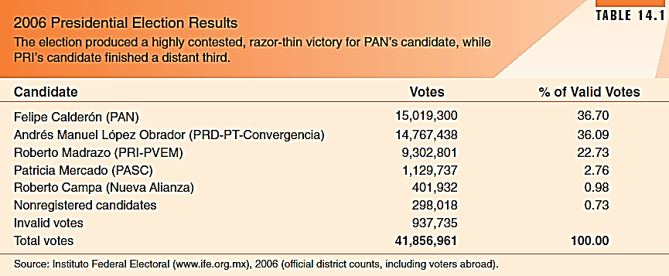

Slide 22
Political Institutions and Structure
Lecture 2

Slide 23
Your reading homework
P. 448-451

Slide 24
Classifying Mexico’s Government
Since the 50’s they have been depicted as an one part state evolving towards “true” democracy (American Style)
Become labeled as “authoritarian” during the dirty war
Sometimes they are labeled as: “selective democracy,” “hardline democracy,” or “democradura”
Slowly becoming not considered “one party authoritarian” since they are having more competitive elections

Slide 25
Evolution
Becoming more democratic since 2000:
Low tolerance of electoral fraud, repression of dissidents, heavy control of media.
Higher scrutiny of the government institutions now than ever before.
Since 1997, the legislature has been not held by a majority of either chamber.

Slide 26
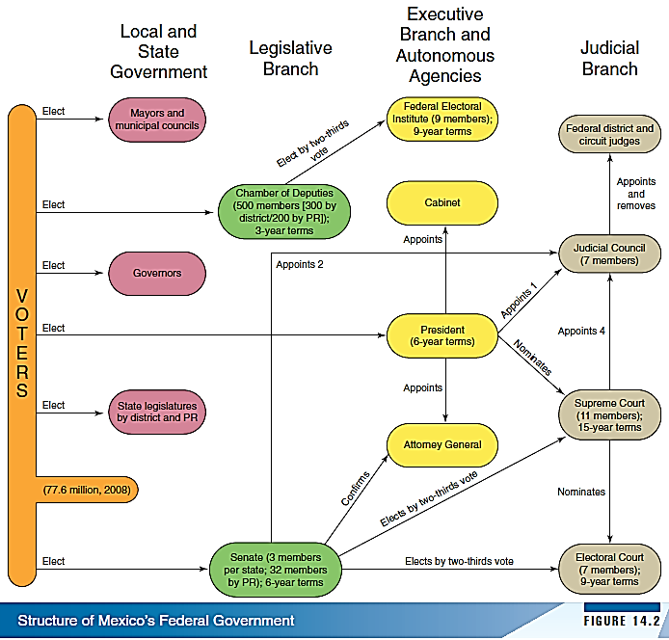

Slide 27
Political Structure and Institutions
Federalism: A Double-Edged Sword
Political centralism
31 states and Federal District (p. 441 compare to USA)
Each divided into municipios headed by mayor and council
Each layer of government successively weaker

Slide 28
Struggle Against Centrism
Has been held by the last 7 presidents.
Only attempted to decentralize post 1984
Some revenue sharing done to boost the local governments.
Some successful devolution of education and healthcare to the states.
Prez. Zedello wanted an agreement to create a legal framework for “Mexican Federalism”

Slide 29
State Governors are the Enemy
They control all of the state’s resources obtained from the federal government.
All governors have resisted devolving their own power back to the municipo level.
Will be many roadblocks to a US-style of federalism even if there is a pro-decentralization federalism.

Slide 30
Less Democratic States
They have not democratized at the same rate.
There are several states still dominated by the PRI (Tabasco, Oaxaca, Puebla, Veracruz).
Predominantly in rural areas.
Puebla is a case study in PRI Power
Manuel Bartlett (PRI Governor) passed a law to prevent revenue sharing with cities governed by the PAN.
Has been copied by other several pro-PRI states.

Slide 31
The Legislature
128 member Senate (upper house)
500 member Chamber of Deputies (lower house)
The electoral system is ridiculously complicated:
Some use SMP
Some use PR
Some use PR from closed party lists (part of senate)

Slide 32
The Senate
31 states, each party nominates 2 candidates.
Party that wins plurality sends 2 candidates.
Party in 2nd sends their 1st candidate on list to senate.
32 senators picked from closed national lists in a PR style election.
2% = at least a share of the seats
Cannot control more than 2/3 of the Senate (unless you won every election)

Slide 33
Chamber of Deputies
300 Elected by SMP
200 By PR in 5 regional list votes.
Again, the 2% rule exists
No party can have more than 300 seats (so less than 2/3 majority for reforms).
Also cannot have more than 8% of its share from the national percentage.

Slide 34
A Nightmare for Duverger
Mixed representation has lead to a 3 party system.
Most regions have 2 party system, but whole state not dominated by same 2 parties.
Multiple parties have representation (Mexico group will discuss these on Thursday.)

Slide 35
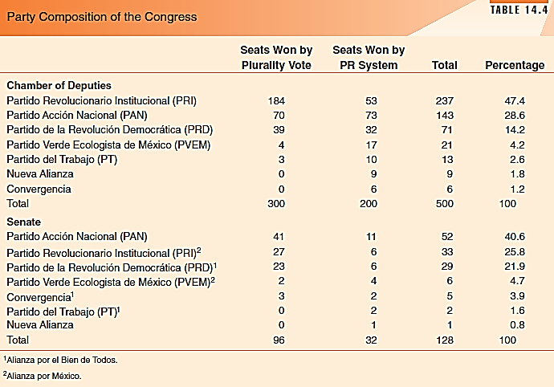

Slide 36
I’m Just a Bill
We are going to discuss the table on P. 444 (open your books!!!!!!!!)

Slide 37
The Legislative Branch
Presidential vetoes can take two forms
Regular veto: president rejects bill
Corrective veto: president requests Congress amend bill
Either: Congress can insist on original text of bill by two-thirds vote
Powers of Chambers
Each has exclusive powers and areas of specialization
Party discipline
Very strong, each party generally votes as bloc

Slide 38
Powers of the Legislature
Senate
Chamber of Deputies
Foreign Affairs
Remove state governors and depose legislators
Can topple with majority vote, and President can propose a list of replacements, sen. Picks by 2/3 vote
Happens mostly for security reasons
Controls federal-state revenue sharing pacts
Fiscal Legislation
Revenue and tax legislation
Can influence the whole federal administration
Approves all public Accounts

Slide 39
The Executive Branch
Presidencialsimo---huge concentration of formal and informal power in the President’s hands
The supreme court adheres to most presidential directives.
Lack of a rigid ideology for parties allow presidents to be somewhat flexible.

Slide 40
The PRI and a Strong President
Three factors
Majority in both houses, in divided government it is hard to deal with opposition.
High levels of discipline in the majority party (block votes).
President must lead party, create the strong directive
Perfect example is the election of Cardenas and his restoration of his party’s faith in him.

Slide 41
Your reading homework
P. 448-451

Slide 42
Lecture 3.1: Political Parties
P. 451-458 (Covered by the Mexico Group)

Slide 43
Lecture 3.2: Government Performance
P. 458-466

Slide 44
Promoting Economic Growth
State has been instrumental in development since the 1940’ (especially with infrastructure and development banks)
1940-1970—corporatism has increased capital accumulation. (limited consumption and redistribution of wealth).

Slide 45
Promoting Economic Growth
Mexican Miracle (1950-1970)
Sustained 5-6% growth rates
Jumped to the top of the list of “Middle developed countries”
Most of the money came from oil control (15bil per year)

Slide 46
Declining Poverty Rates
1950-1980 saw a decline in “absolute poverty”
Middle class grew to 29% of the population
Adult illiteracy dropped to 8% (from 35)
Infant mortality dropped to 15% (from 78)
However, land concentration and income inequality remained unchanged.
The statistics above remained relatively unchanged for rural areas

Slide 47
Good things End
1982 financial crisis
Externally held debt was being called in
Lost commitment to social well being of its citizens
Wages dropped

Slide 48
New Development Models
Neoliberalism
More free reign to market forces
More private investment and shrink the public sector of the economy
Full embracement of private investment in controlling things like government programs (least willing to forfeit)

Slide 49
Rule of Law
This is where they tend to fail the most since the 90’s
Ineffective at dealing with street crime
In the 90’s surveys showed that all citizens have been the victims of a crime
Homicide rates rose by 211-230% in some states

Slide 50
Pushing the Rule
President Zedillo did the following:
Reduced the supreme court in size
Increased term length
Changed requirements for appointment votes
The problem
Striking down laws required a supermajority of justices to act, which was impossible.
Didn’t change at the state level

Slide 51
The Drug War
http://www.youtube.com/watchv=F01eO2GTbQg
I’d also read p 462-463 if I were you!

Slide 52
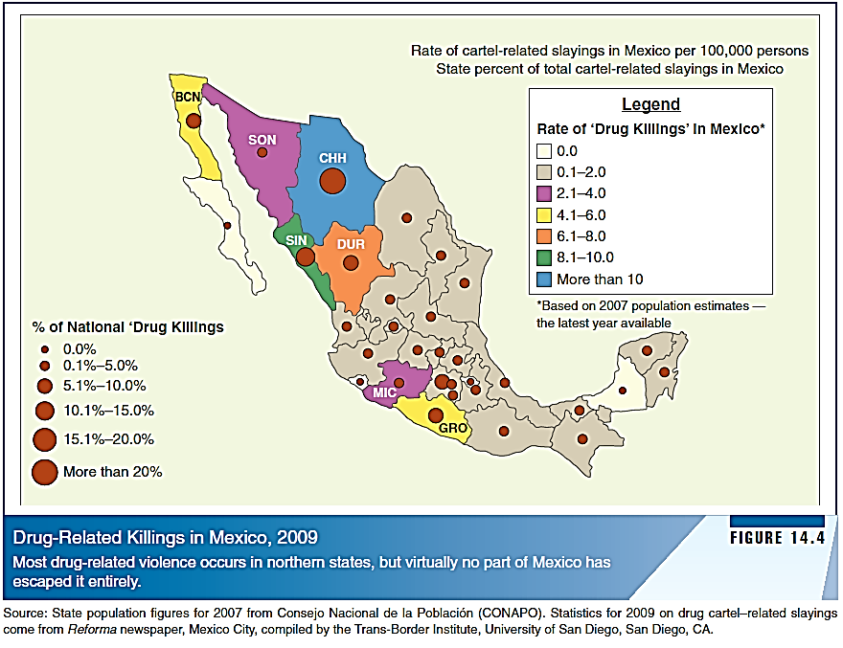

Slide 53
International Environment
Mexico’s proximity to US a major influence
Mexican-American War 1846-48: lost half of national territory to US
WWII: US needed migrant laborers
2009: 11% of Mexicans living abroad, most in the US
US stake in Mexico: political stability, economic development

Slide 54
Mexico’s Political Future
Transition to Democracy:
Elections are as democratic, transparent as any other country in Americas
Talk of changing Constitution of 1917 to weaken presidency and strengthen Congress
Should be classified as a democracy, one of best functioning in Latin America

