Slide 1
Politics of China Chapter 13!

Slide 2
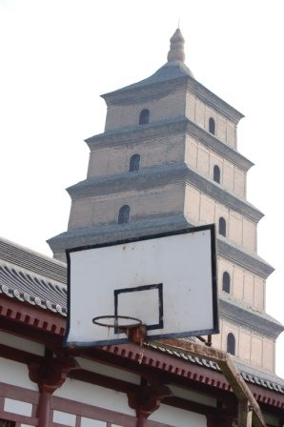
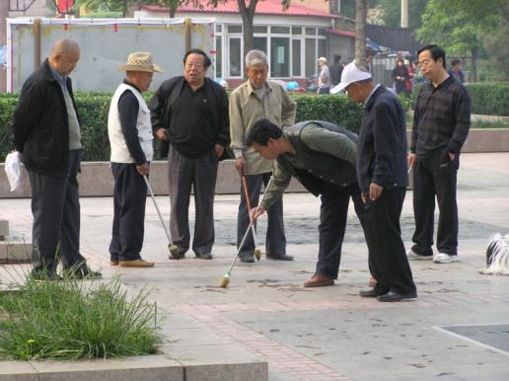
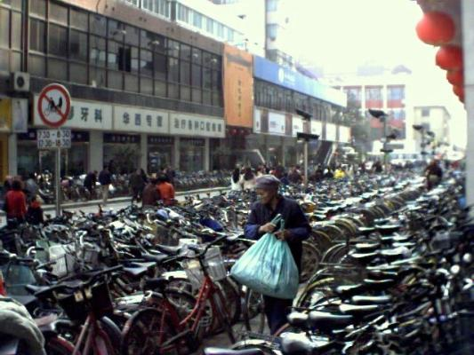
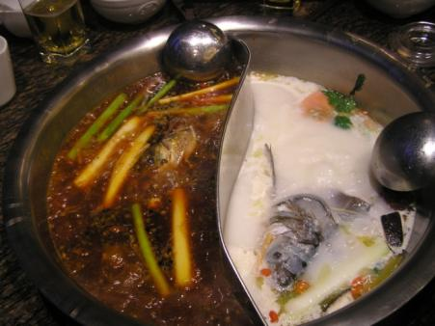
What do you
Know
About
CHINA?

Slide 3
Which of the following is false:
China has 300+ million Internet users
China has 1.5 cell phones per household
16 of the world’s 20 most polluted cities are in China
McDonald’s opens a new restaurant every three days in China
China allows one child per person, so two per couple
Answer: E – only 1 is allowed
Notes:
China with 298 million (2009) – 1 in every 4 has access

Slide 4
I wonder if it is more crowded in New York?
Population size: US vs. China…
1.3 billion compared to 307 million – or 4x the size!
Rural populations: China 45%, US 2%
In China: 16 births/minute In US: 8.5/min
946/hr
690,416/month
Notes:
Annual Growth rate of China 0.65%, US 1%
http://www.census.gov/population/www/popclockus.html
These are births, not overall net gain…
Rural pop amounts to approx 800 mil people, more than 2.5x pop of entire US

Slide 5
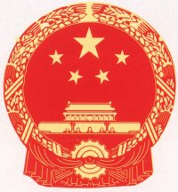
Which of the following is not a policy found in China today?
Reeducation through Labor
Employer permission to marry or divorce
Household registration
Execution for bribery/corruption
One Child Policy
Answer: B (it ended with the Marriage Law of 2003)
Notes:
E ended in 2003
F is still found today but is no longer guaranteed for new workers

Slide 6
Which of the following statements about China’s development is false?
China has averaged 8% growth annually since 1978
China uses ½ of the world’s cement
China is the third largest economy after the US and Japan
The state owned sector still controls 1/3 of all industry in China
Less than half of China’s population is employed in agriculture

Slide 7
Answer: C
China became the 2nd largest economy in 2010

Slide 9
China – Part 1
Pronunciation guide
Demographics & Basic characteristics
Political History
Institutions & Succession
Economic Reform

Slide 10
Pronunciation Guide
Q = ch (Qin = Chin)
X = sh (Liu Xiaoqi = sh-ow, chee)
C = ts (“ch” = ch but “c” alone = ts)
Zh = j (Zhou = joe)
Chinese names are ordered last names first
Mao Zedong, Deng Xiaoping, Jiang Zemin, Hu Jintao

Slide 11
People’s Republic of China
22.5 provinces
5 ARs
4 municipalities
2 SARs
Notes:
Looks like a chicken
Guangxi, Nei Mongol, Ningxia, Xinjiang Uygur, Xizang (Tibet) – Ars = autonomous regions
Municipalities = tianjin, beijing, chongqing, shanghai
Special administrative regions = HK and macao
Taiwan is the 23rd province

Slide 12
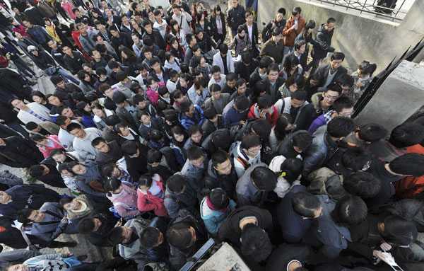
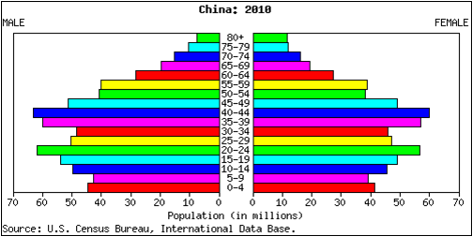
Demographics
Population = 1.3 billion
Rural/urban divide (55/45)
92% Han
200mil “floating”
Province/country parallels

Slide 14
Population (mil) of selected countries (2009) & Chinese provinces (2008)
China 1338
India 1166
USA 307
Indonesia 240
Brazil 198
Pakistan 176
Bangladesh 156
Nigeria 149
Russia 140
Japan 127
Mexico 111
Guangdong 113
Henan 99
#12 Philippines 98
Shandong 92
Sichuan 87
Jiangsu 75
Hebei 68
Hunan 67
Anhui 65
#22 UK 61
Hubei 60
Chongqing 31
Shanghai 20+ (#50)

Slide 15
City comparisons: China has 100+ cities w/ 1mil+ people, the US only 9
Chongqing 31 mil
Xian 22.4 mil
Chengdu 22.1mil
Shanghai 20 mil+

Slide 16
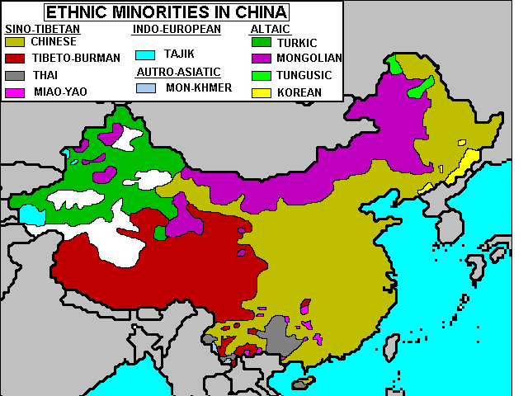

Slide 17
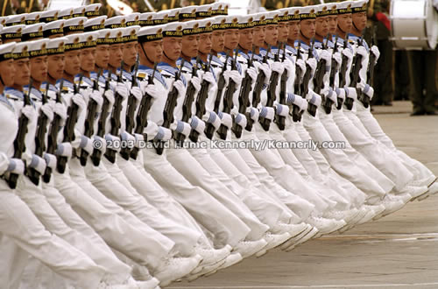
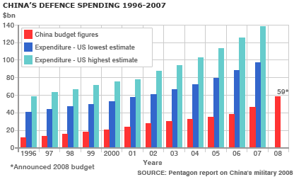
Characteristics of the Modern Chinese state…
Military = 2.3 million
PLA largest army (73%PLA, 17%AF, 10%N)
Budget & modernization concerns

Slide 18
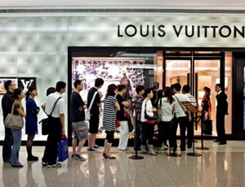
Characteristics of the Modern Chinese state…
Economics = “socialism with Chinese characteristics”
8-15% growth (GDP)/year (10.3 % in 2010)
Rising standard of living and GDP/capita ($7,000)
2nd largest luxury market
Foreign trade increasing 15%/year

Slide 19
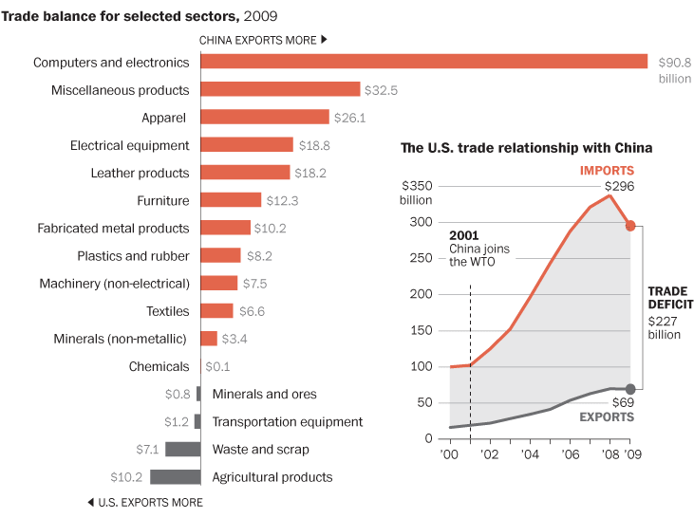
US Trade Deficit with China….
1990-1994 $25 bil USD/yr
1994-1998 $50 bil USD/yr
2004 = $162 bil USD
2005 = $201.6 bil
2006 = $232.6 bil
2007 = $256.3 bil
2008 = $268 bil
2009 = $223 bil
2010 = $270 bil

Slide 20
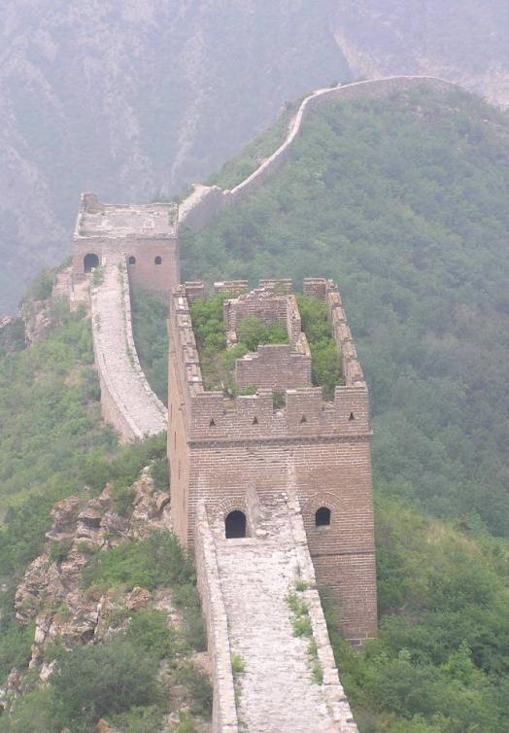
Politically interesting…
History & Culture
Rise of Mao
Institutions
Leaders & succession

Slide 21
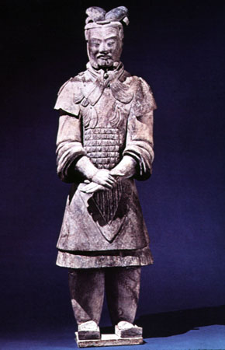
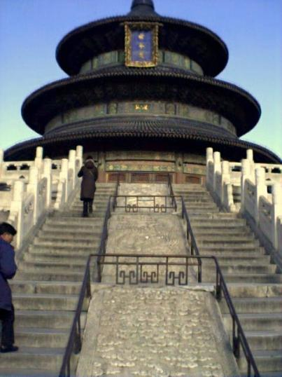
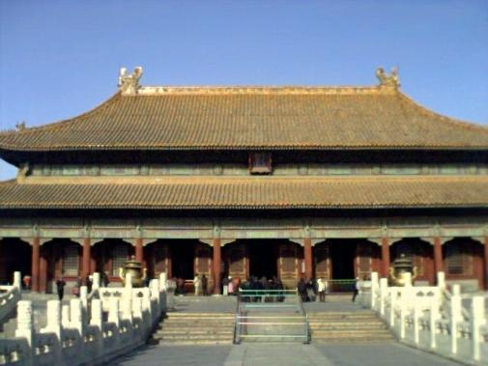
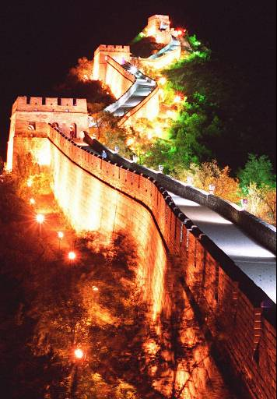
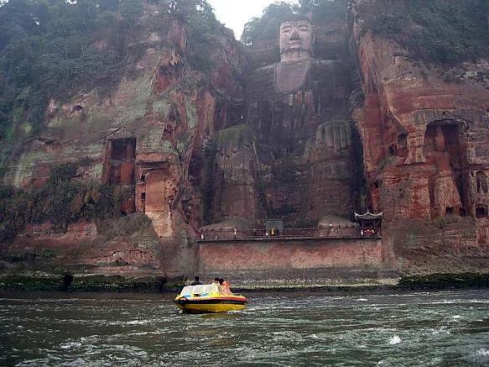
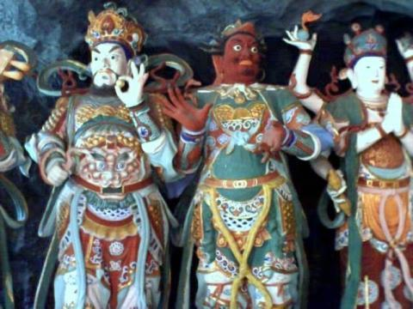
Culture & Society 5000 years of civilization

Slide 22
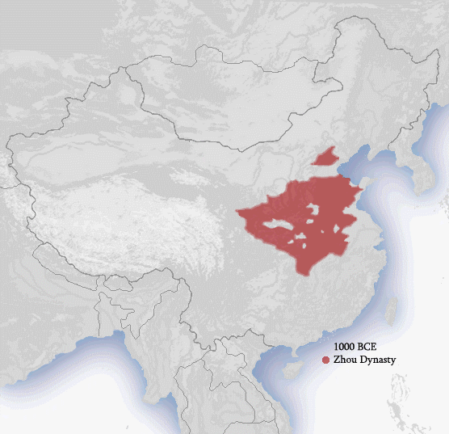
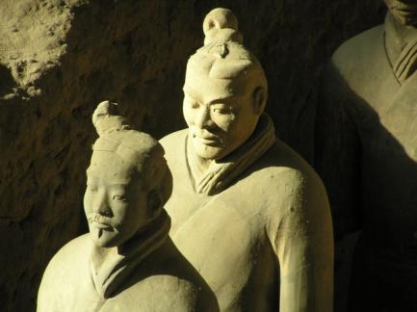
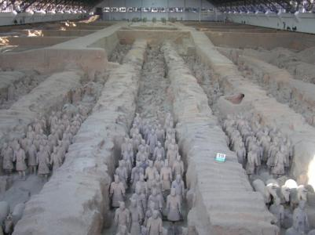
Political History
Imperial era
Sino-centrism & the “Middle Kingdom”
Qin Shi Huangdi (221-206 BC)
Qing (1644-1911) – Manchu
Confucian culture
Harmony, collectivism, saving face
Education
Family

Slide 23
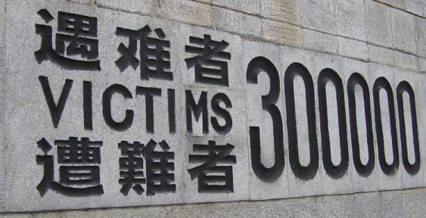
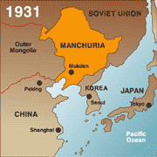
Century of Shame & Humiliation
1842 ~ Opium War
1856-69 ~ Second Opium war
1894-95 ~ First Sino-Japanese War
1900 ~ Boxer Rebellion
1919 ~ Treaty of Versailles
1931 ~ Japan takes Manchuria
1937 ~ Nanjing

Slide 24
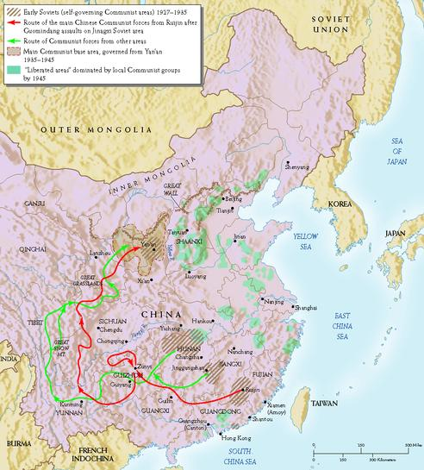
Revolution & the Rise of Mao
The Long March 1934-35
GMD/KMT =
Guomindang
Kuomintang
CCP =
Chinese Communist
Party

Slide 25
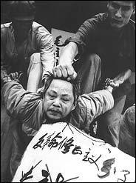
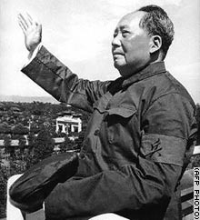
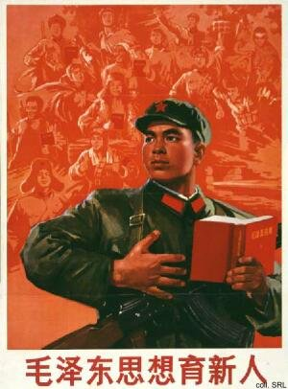
The Mao years (1949-1976)
Mao’s Political Culture
Struggle
Elevated status of peasants
Democratic centralism
Mass line
Propaganda & campaigns

Slide 26
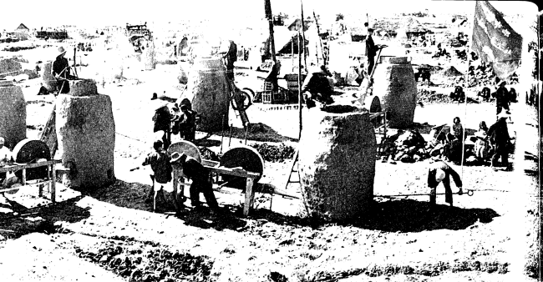
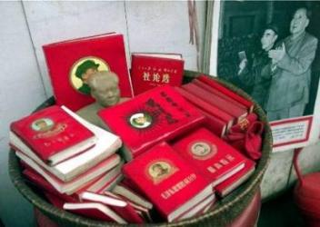
Mao’s Campaigns
Let a Hundred Flowers Bloom (1956)
Anti-rightist campaign
Great Leap Forward (1958)
Misreporting & disaster
Great famine
Cultural Revolution (1966)
Attack on elitism/capitalism/ bourgeoisie
Barefoot doctors
Education disrupted
Youth “sent down”

Slide 27
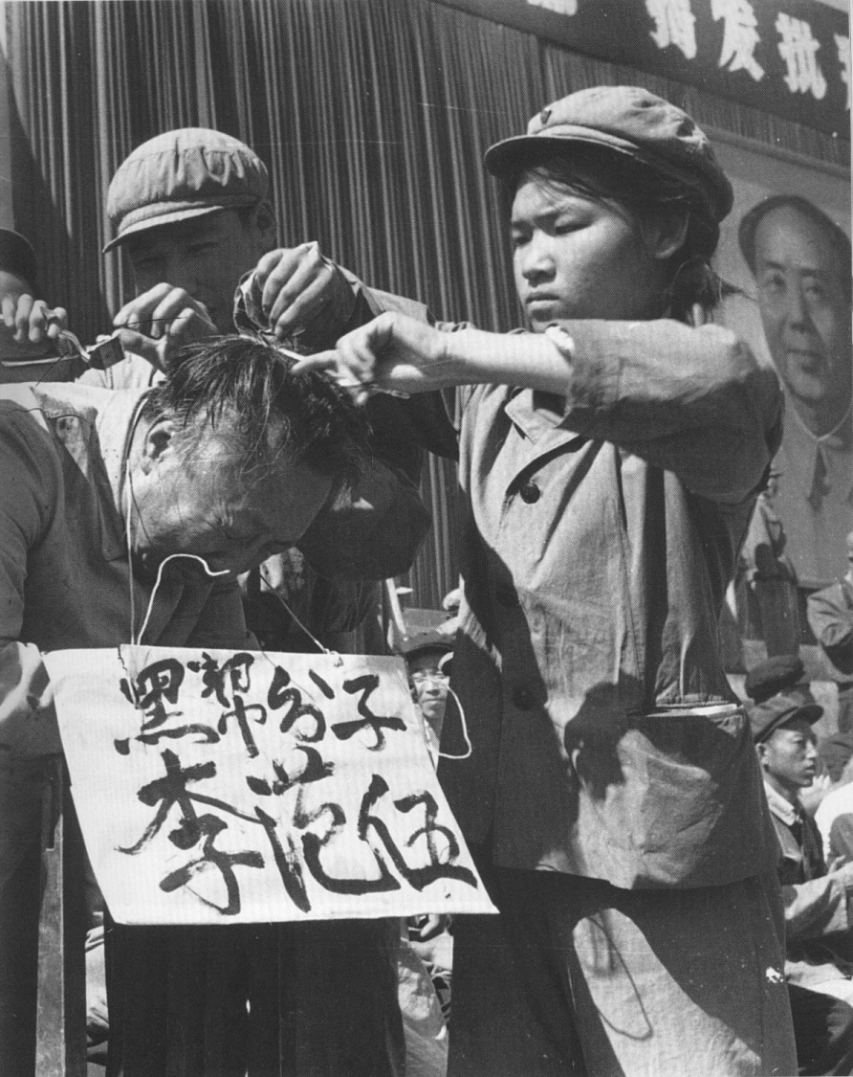
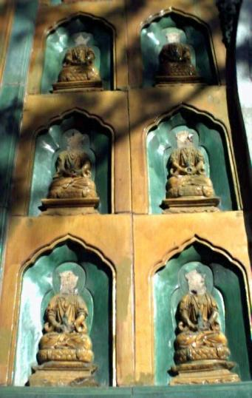
Struggle & Destruction

Slide 28
Chinese Political
Organization
Party
Organs
Government Organs
Legislative Organs

Slide 29
Politburo Standing
Committee
Politburo
Central
Advisory
Commission
Central
Committee
Military Affairs
Commission
Pres &
VP
Secretariat
National
People’s
Congress
PLA
State
Council
(premier)
NPC
Standing
Committee
China’s Party, State &
Legislative Organs

Slide 30
Match the following individuals with their political information:
Jiang Zemin
Mao Zedong
Hu Jintao
Xi Jinping
Wen Jiabao
Li Peng
Deng Xiaoping
“Butcher of Beijing” held ‘responsible’ for the Tiananmen Square massacre
Known as the great helmsman and the only Chairman of China
Former president, known for opening China to economic reform
Most recent president/party head
Current premier
Former president who allowed capitalists to join the Party
The Current leader of China

Slide 31
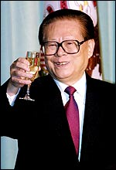
Jiang Zemin
“Butcher of Beijing” held ‘responsible’ for the Tiananmen Square massacre
Known as the great helmsman and the only Chairman of China
Former president, known for opening China to economic reform
Most recent president/party head
Current premier
Former president who allowed capitalists to join the Party
The Current leader of China

Slide 32
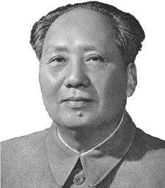
Mao Zedong
“Butcher of Beijing” held ‘responsible’ for the Tiananmen Square massacre
Known as the great helmsman and the only Chairman of China
Former president, known for opening China to economic reform
Most recent president/party head
Current premier
G. The Current leader of China
Next… Hu Jintao

Slide 33
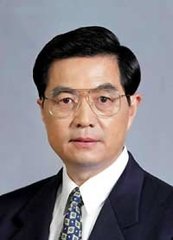
Hu Jintao
“Butcher of Beijing” held ‘responsible’ for the Tiananmen Square massacre
Former president, known for opening China to economic reform
Most recent president/party head
Current premier
F.
G. The Current leader of China
Next… Xi Jinping

Slide 34
“Butcher of Beijing” held ‘responsible’ for the Tiananmen Square massacre
Former president, known for opening China to economic reform
Current premier
F.
G. The Current Presidentof China
Xi Jinping
Next… Wen Jiabao

Slide 35
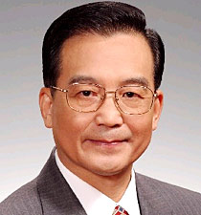
Wen Jiabao
“Butcher of Beijing” held ‘responsible’ for the Tiananmen Square massacre
Former president, known for opening China to economic reform
Current premier
Next… Li Peng

Slide 36
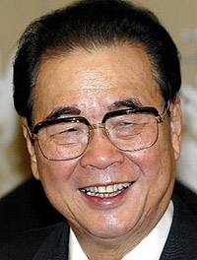
Li Peng
“Butcher of Beijing” held ‘responsible’ for the Tiananmen Square massacre
Former president, known for opening China to economic reform
Next… Deng Xiaoping

Slide 37
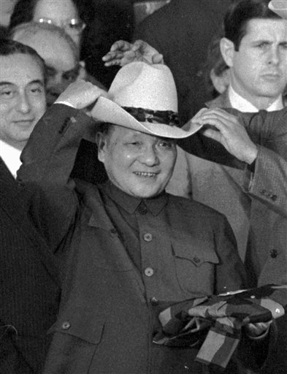
Deng Xiaoping
C. Former president, known for opening China to economic reform

Slide 38
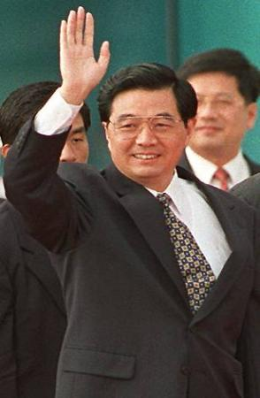
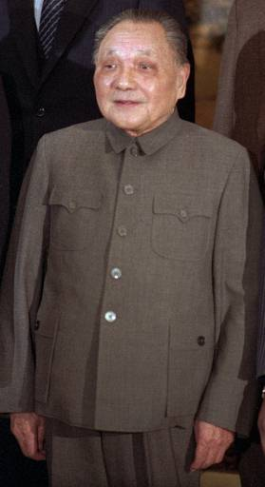
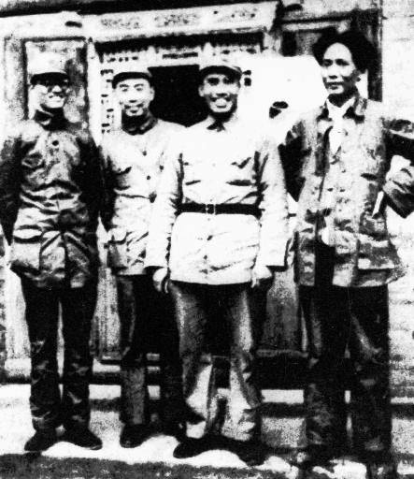
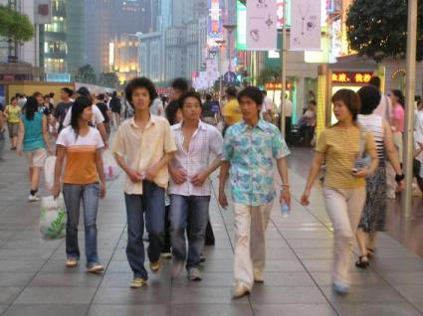
Succession & Transition
1 = Mao
2 = Revolutionary/Long March generation
Deng Xiaoping
3 = Party/Guanxi risers
Jiang Zemin
4 = Technocrats
Hu Jintao
5 = princelings?? (Xi Jinping)
Lost Generation?
Capitalist Generation

Slide 39
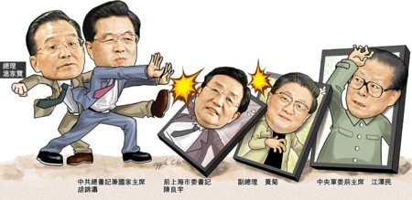
16th PBSC Members
Hu Jintao → Pres, MAC, Gen Secretary → Deng
Wu Bangguo → NPC Chair → Jiang
Wen Jiabao → Premier →Zhao Ziyang/Zhu Rongji (Deng)
Jia Qingling → CPPCC Chair → Jiang
Zeng Qinghong → VP of State, Secretariat → Jiang
Huang Ju → Vice Premier → Jiang
Wu Guangzheng → Jiang
Li Changchun → Jiang
Luo Gang → Li Peng (Chen)
Who’s out?

Slide 40
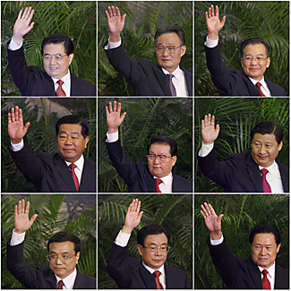
17th PBSC
Hu Jintao
Wu Bangguo
Wen Jiabao
Jia Qinglin
Li Changchun
Xi Jinping
Li Keqiang
He Guoqiang
Zhou Yongkang
Who’s after Hu?

Slide 41
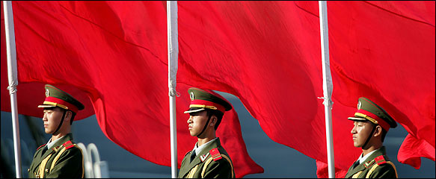
More “institutions”?
Fragmented authoritarianism
State control over organizations/unions (no civil society)
Guanxi (relationships)
Patron/client ties

Slide 42
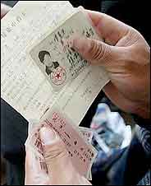
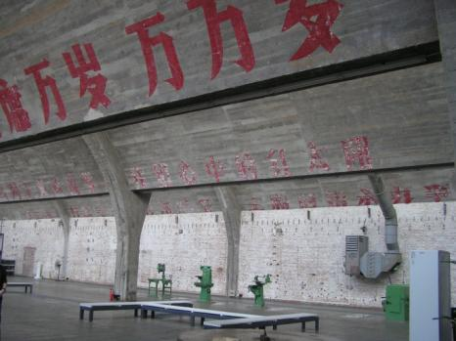
Economic Legacy of the Mao system
Hukou (registration) restrictions
State Owned Enterprises (SOEs) & the iron rice bowl
Danwei (work unit)
Regional economies

Slide 43
The Chinese Economy…
http://www.youtube.com/watch?v=OTSQozWP-rM

Slide 44
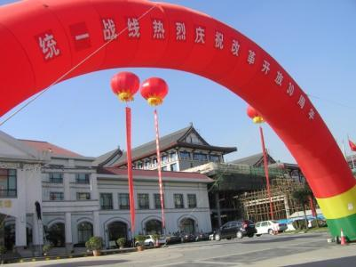
Socialism w/Chinese characteristics?
Gradualist approach
Deng’s “reform & opening” (1978+)
Agricultural reform
1980 SEZs ~ Pearl River Delta (PRD)
Late 1980s ~ iron rice bowl cracks, SOE restructuring
Early 1990s ~ privatization & IOEs

Slide 45
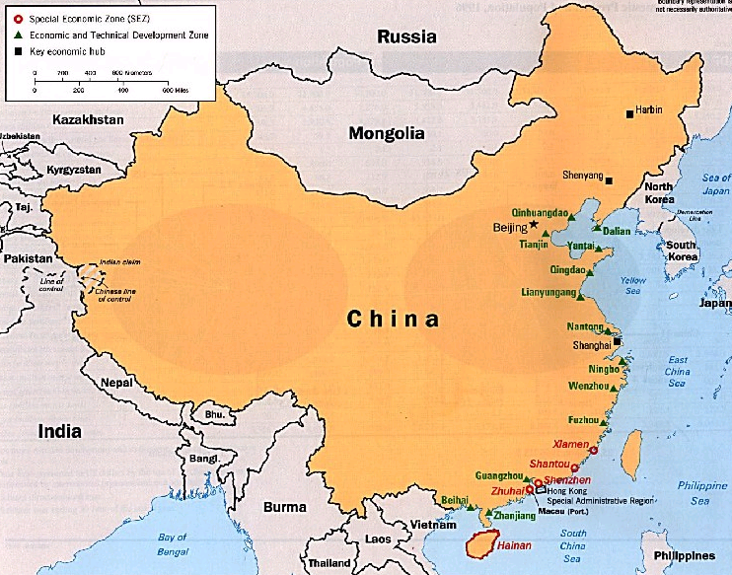
SEZs – Reform & Opening
1980 = 4 SEZs (PRD)
1984 = 14 more cities
(YRD & NE)

Slide 46
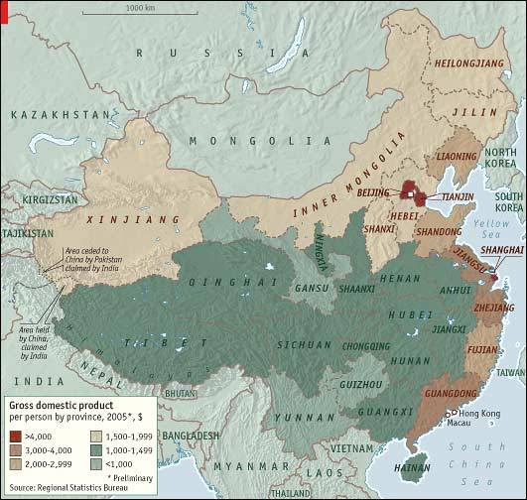

Slide 47
More stages…
1997-2001
Danwei role deteriorating
Flower vases
SOE & IOE split
Consumerism & “affluenza”
Service sector development
2001-2005 – “Go West”
2006-2011 – “Socialist Countryside and Harmonious Society”
Notes:
Affluent houses, dog ownership, weddings,

Slide 48
Key economic changes:
Banking reform (privatization & division)
Currency reform (managed float)
Unemployment (xiagang stats)
WTO entry (2001)
Energy/resource needs expanding
Urban development & anti-rural bias?
Notes:
Division of banking into separate banks – commercial, ag, etc (loans, LT investment, and ag) but still all bank of china – inefficient and gives bad loans to SOEs
Used to HAVE to give loans to SOEs (even if failing)
Energy/resource needs causing security/econ linkages

Slide 49
Why anti-rural?
Notes:
Diff pics of what beijing and other cities look like in china – foreigners don’t want to see that!!
2001
Talk about busses… ugh

Slide 50
Notes:
Car wash
2006 pics – things get more modern

Slide 51
Notes:
2008 pics – more modern still!!! This is the china foreigners want to see – mdoern companies, dogs walking, high rise buildings, starbucks and foreign mags, minicabs to get you from plac eto place.
Williamson dickie –

Slide 52
Challenges for the modern state
Inequalities
Banking reform & currency issues (USD)
Labor problems – xiagang, migration, contentious pensioners
Social safety net
Pollution & energy issues

Slide 53
Challenges for the Modern State
Political concerns: transparency, rule of law, development of civil society, succession
Corruption
Human rights pressures
Information regulation

Slide 54
Advanced Topics on China (AKA China continued…)
Population Policy
Human Rights
Civil Society & unrest
Legal Issues

Slide 55
China's One-Child Policy and the Chinese Family

Slide 56
Family Planning Debates
Malthus and carrying capacity
Demographic transition
Goals of family planning
Notes:
Goals – pop decline and increase in development

Slide 57
China’s Population
 | Population
1950 | 554.7 mil
1960 | 667.5 mil
1970 | 830.7 mil
1980 | 998.9 mil
1990 | 1,155.3 mil
2000 | 1,265.9 mil
2010 | 1,326.8 mil
2020 | 1,361.6 mil
2030 | 1,350.6 mil
Notes:
Pop doubles in just 40 years!

Slide 58
Family Planning Historical Overview
Early 1950s (pronatalist), mid-50s (antinatalist), early 60s (pronatalist)
1971 – 5 year plans w/pop targets
Mid-1970s “wan, xi, shao”
1978 Deng links econ development with pop
Minorities exempt

Slide 59
Policy Logistics
No formal national law in 1979
Encourage one
Control/regulate a second
Prohibit/eliminate/ban a third
Basic regulations:
“Among government cadres, workers and urban residents each couple shall have only one child, with the exemption of those who for special reasons have obtained permission to have more than one child. In rural areas, couples should limit themselves to a single child, but some couples may be given permission to have a second child… No one is allowed to have a third child…”
Central Committee & State Council Recommendations (1982)

Slide 60
Allocation and Implementation
Implementation:
Provincial authority & variation
Birth planning commissions
Grass-roots monitoring
Allocation:
Validation: marriage certificates, work unit, neighborhood committee
Quotas allocated – “birth planning certificates”
Additional births subject to county/city district approval (not local)
Paperwork stamped/certified
After birth: certification & monitoring

Slide 61
2002 Population and Family Planning Law
Article 17: “Both husband and wife bear equal responsibility for family planning.”
Article 22: “…maltreatment, and abandonment of baby girls are prohibited. “
Article 26: “Citizens who undergo surgical operation for family planning shall enjoy leaves as specified by the State. Local people's governments may give them rewards.”
Article 27: “Where the only child of a couple is disabled or killed in accidents, and the couple decides not to have or adopt another child, the local people's government shall provide the couple with necessary assistance.”

Slide 62
Family Planning Law…
Article 35: “Use of ultrasonography or other techniques to identify fetal gender for non-medical purposes is strictly prohibited. Sex-selective pregnancy termination for non-medical purposes is strictly prohibited.”
Article 41: “Citizens who give birth to babies not in compliance with the provisions of Article 18 of this Law shall pay a social maintenance fee prescribed by law.”

Slide 63
Enforcement
Different stages of enforcement
Exceptions
Son preferences
Forced sterilization
Monitoring of menstruation
Contraception challenges & abortion
Abandonment & adoption
4-2-1 problem

Slide 65
Sex Ratio Problems
Skewed sex ratios
Normal 103:100
145:100 Shaanxi
116:100 national average
200:100 Tianjin (2nd order)
1,100 :100 [rural] (3rd order)

Slide 66
“Cultivating the perfect only child”
Education pressures (cost, schools, extracurriculars, etc) & competition
Little emperors
Social security role – must invest
“one child = one opportunity”

Slide 67
Human Rights…

Slide 68
China’s Human Rights Problems
China
Most executions/year (5000+)
Political prisoners
Lack of religious toleration
Forced labor of prisoners
Organ harvesting
US has tried to link human rights to trade policies
with China but has had to abandon them

Slide 69
Human Rights in China
Western view
Political rights are also important
Point to Tiananmen square massacre
Point to reeducation through labor
Point to dissidents and suppression of free speech, internet control, etc..
Deteriorating econ rights in China post reform
No sense of worker rights – unions, strikes, etc

Slide 70
More Areas of Concern for China on HR:
Imprisonment, arbitrary detention and forced exile based on political ideas
Religious repression – arrests and beatings of practitioners
Absence of safeguards against police abuse, unlimited detention without trial, etc
Treatment of minorities – population relocation policies (Xinjiang, Tibet)
Hukou restrictions
Forced abortion, sterilization as a result of the One Child Policy

Slide 71
Reeducation through labor
Local authorities determine sentence (1-3 years) – no rights to lawyer and sometimes no charge filed
Reeducation crimes: hooliganism, disturbing the social order, those who associate with criminals, violating administrative norms, organizing illegal meetings

Slide 72
Civil Society & unrest
Civil society – formal and informal organizations that are not part of the staet but operate in public. It is composed of voluntary organizations that are autonomous and self-governing to advance their own causes.
Groups of Interest: labor groups, religious groups, minorities, netizens

Slide 73
State vs. Societal Corporatism in China
State, unions, business are all together as “China Inc.”
State is insulated from interest-groups – uses its power to co-opt other interests
Rules on the types of organizations that can be formed (Labor – ACFTU)
Societal corporatism allows for civil society to flourish

Slide 74
Organizational Restrictions
Requirement of a “sponsor organization”
Many organizations are stretched thin and do not want to sponsor new group
1996 restructuring added new requirements and “re-approval” for groups
Requirements for recognition: 50,000 Yuan in funds, a support staff, and a permanent office
Marginalized groups attempt to work outside the structure
State connection impedes independent action

Slide 75
Labor Concerns
Xiagang
Contentious pensioners
Gender issues
Rural-urban migration
Migrant industries (coal mining, sweatshops, construction, etc) & worker rights

Slide 76
Religious Groups
100 million religious followers
Problems with the Catholic Church
Churches seen as “foreign” and in 1950s came under state control
Cultural Rev “outlawed” religion (leaders imprisoned)

Slide 77
Falun Gong as “religion”
Spiritual/religious movement condemned by state for spreading “superstitions” – state calls it a cult
Daoist and Buddhist meditation influences
Millions of followers (10 - 100 mil)
Use Qigong
Protests against the state: immolation, demonstrations, defacing Mao’s portrait, hacking TV stations

Slide 78
Minorities
Language concerns – Mandarin
56 national minority groups – each w/one delegate to NPC
92% Han majority (only 100 million minorities)
90% of border areas are minority areas
Key “trouble areas” = Tibet and Xinjiang
History: lamas, resettlement policies, martial law
Isolation – geographical and political
Secession concerns

Slide 80
Netizens
Rise of organizations linked to overseas Chinese (especially funding)
Virtual communities created (websites, chat rooms, message boards, etc)
Cyber-democracy threat
Firewalls, monitoring devices in internet cafes, internet channeled through main servers… all to limit organization/ideas
Crimes against the state & spreading state secrets – liberally defined
Fear as an obstacle to greater activism

Slide 81
Legal Issues: Property Rights

Slide 82
Notes:
Nail houses (dingzhi hu) – people refuse to move for developers. Chongqing house is on an island. . Refused for two years to vacate and developers cut the power/water until they settled in 2007 (2 year battle). Nail houses because people are like stubborn nails and cannot be pounded down with a hammer
March 2007, the People's Republic of China passed its first modern private property law.^{[5][6]} The law prohibits government taking of land, except when it is in the public interest (so they can’t just take it from you). The law strengthened the position of nail house owners, but did not entirely resolve whether making room for private commercial developments was a public interest that entitled the taking of land
Top right is in shanghai, bottom right is changsha (hunan)

Slide 83
Resources of Interest?
Popular Films for use in the classroom:
To Live, Raise the Red Lantern, Shower, Not One Less
World Without Thieves, Blind Shaft, Mountain Patrol, Beijing Bicycle
Wild Swans (nonfiction)
Cultural Revolution Posters: http://www.iisg.nl/~landsberger/map.html
E. Asian History Sourcebook: http://www.fordham.edu/halsall/eastasia/eastasiasbook.html
Internet Guide for Chinese Studies: http://sun.sino.uni-heidelberg.de/igcs/
Wilson Center China Environment Forum: http://www.wilsoncenter.org/index.cfm?fuseaction=topics.home&topic_id=1421
Human Rights issues: http://www.hrichina.org/

Slide 84
Questions?

